Slide 1

NCR - 9505
QER: AGOGO FULL FIELD DEVELOPMENT PROJECT SF300824C003.76 – Intermittent superficial scratches

Slide 2
Pipe section / Details
Item | Traceability / identification
Project number | SF300824C003
Project name | AGOGO FULL FIELD DEVELOPMENT
Pipe section | SF300824C003.76
ST number | ST203.13584
Affected layer / equipment | Zeta spiraling
Length affected | 220m until 704m
Drawing number / MP code / STA / Dimension | Zeta 12 FI09 (MP393)

Slide 3
Overview of anomaly
Problem Description :-
During zeta spiraling for AGOGO FULL FIELD DEVELOPMENT PROJECT SF300824C003.76 (ST203.13584), intermittent superficial scratch due to roller mark on the zeta wire was detected at start length 220m until 704m on pipe.
The details of measurement are as per below.
- Depth : 27um
- Upsetting : 28um
Root Cause :-
The root cause was due to operation roller number 5 worn out due to 1st commercial project monitoring. Currently using with Phosphating coating during initial WRQ and for this commercial production.
Problem Handling:-
According to project acceptance criteria CD_300824C003_str20313584_TR76-78,7C-7D,7F-7H_An_Pressure vault, the maximum allowable criteria for the depth of surface defects is 30um and for the maximum upsetting is 100um. Thus, this defect was accepted as it is.

Slide 4
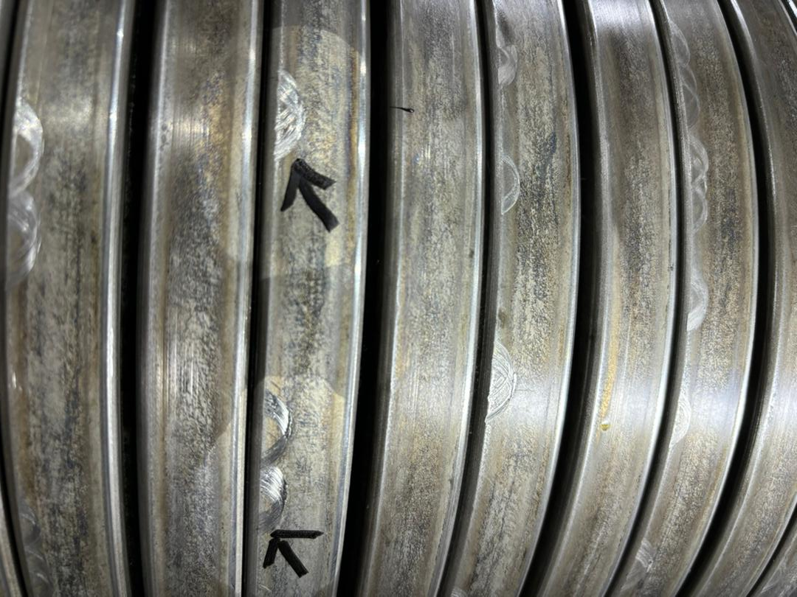
DEFECT PHOTO
Figure 1 : Intermittent superficial scratch due to roller mark on the zeta wire was detected at start length 220m until 704m on pipe.

Slide 5
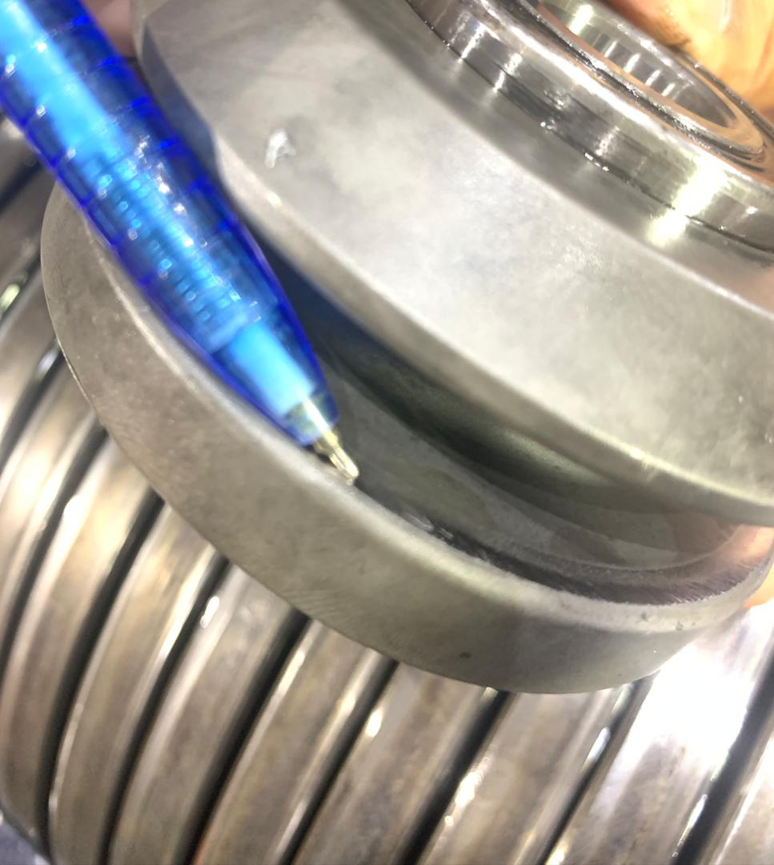
ROOT CAUSE
Figure 2 : The root cause was identified due to operation roller number 5 damaged.

Slide 6
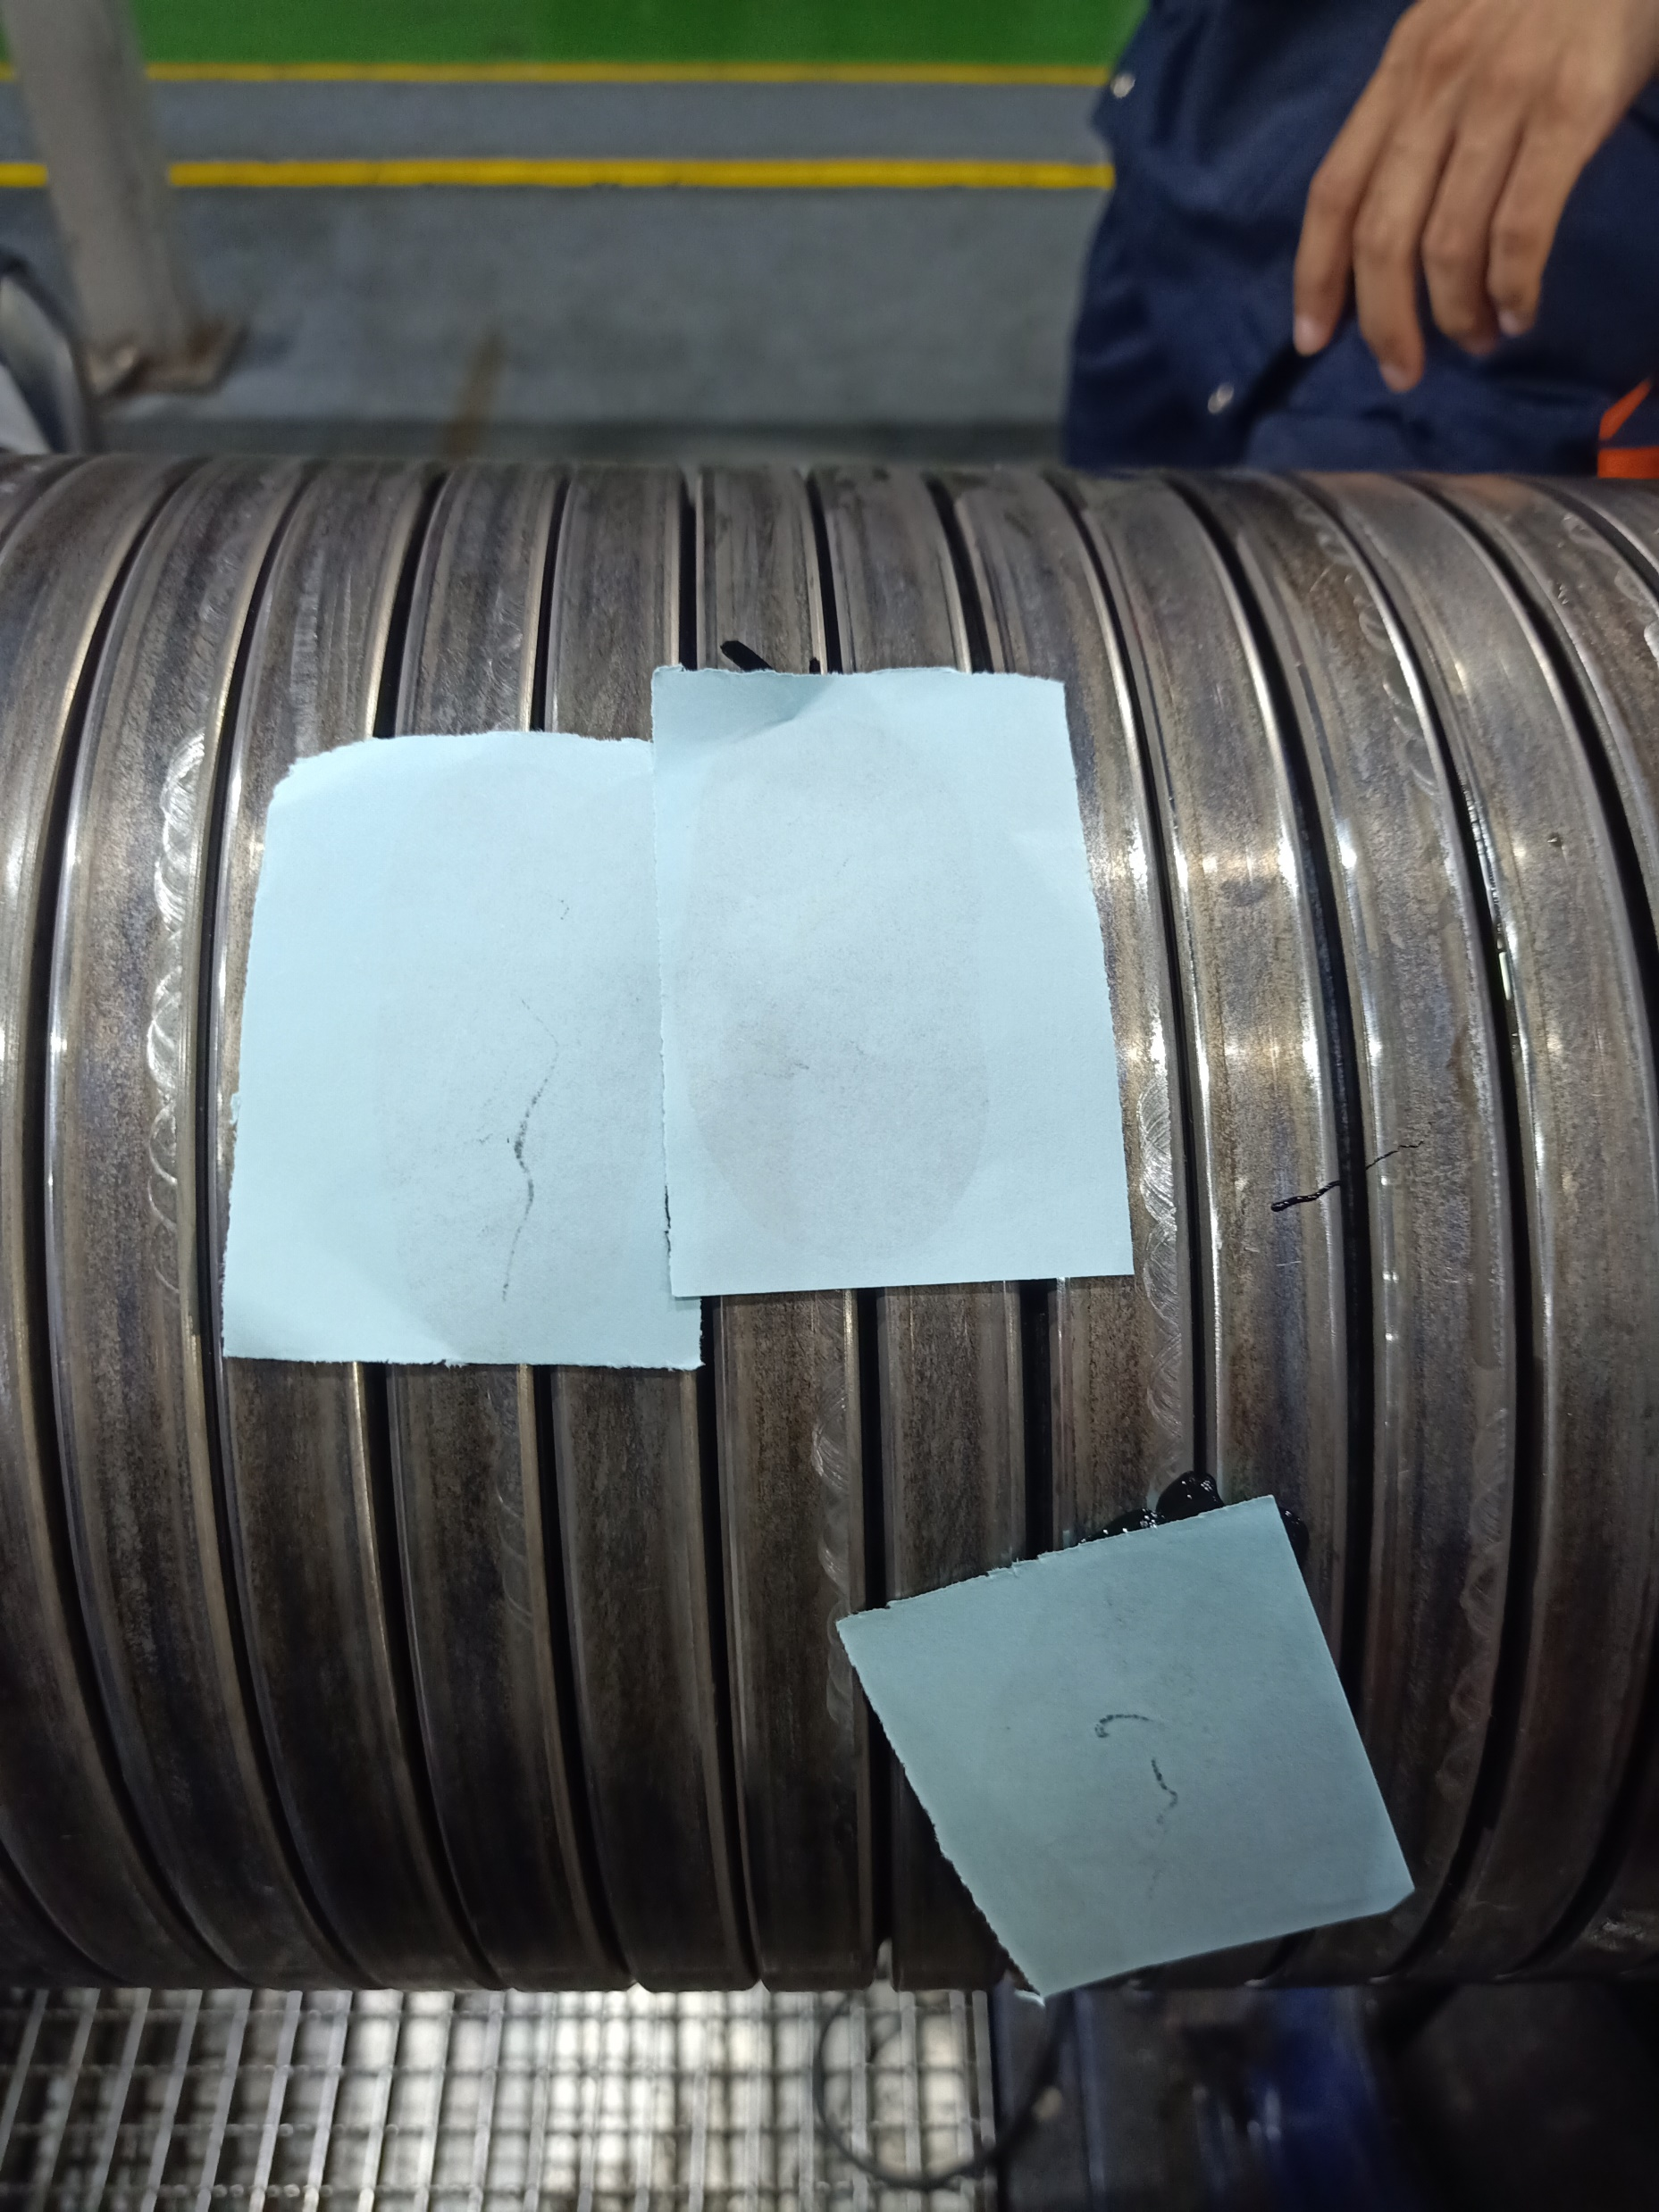
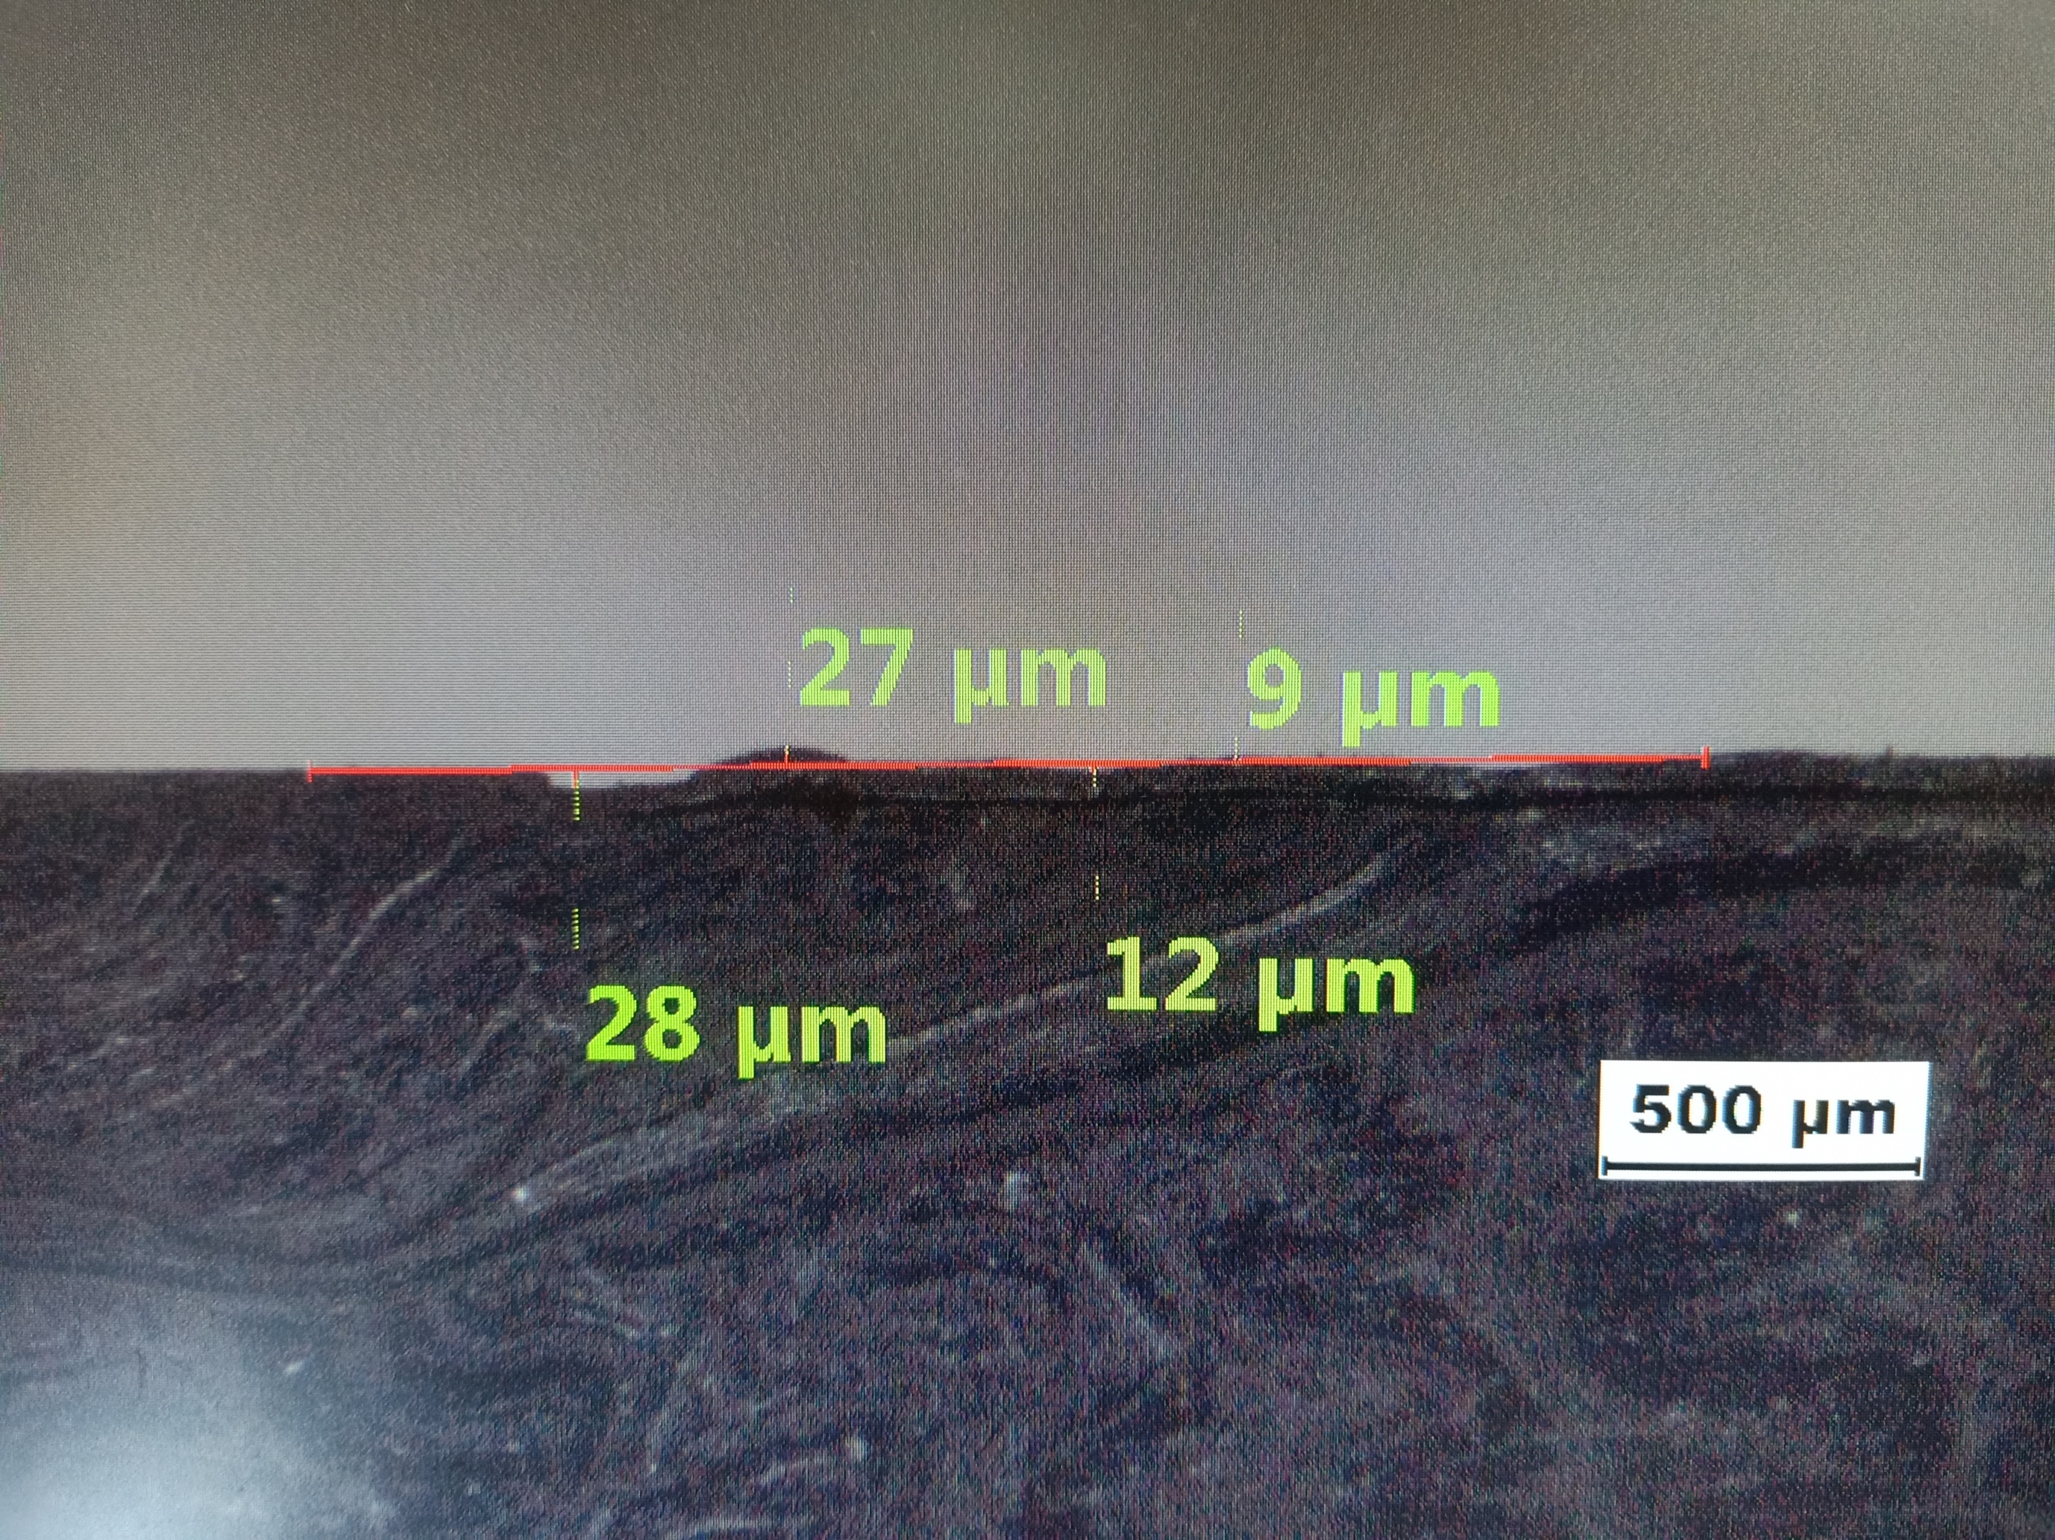
PLASTICOPY MEASUREMENT
Maximum depth
Maximum upsetting
Figure 3 : According to project acceptance criteria CD_300824C003_str20313584_TR76-78,7C-7D,7F-7H_An_Pressure vault, the maximum allowable criteria for the depth of surface defects is 30um and for the maximum upsetting is 100um. Thus, this defect was accepted as it is.

Slide 7
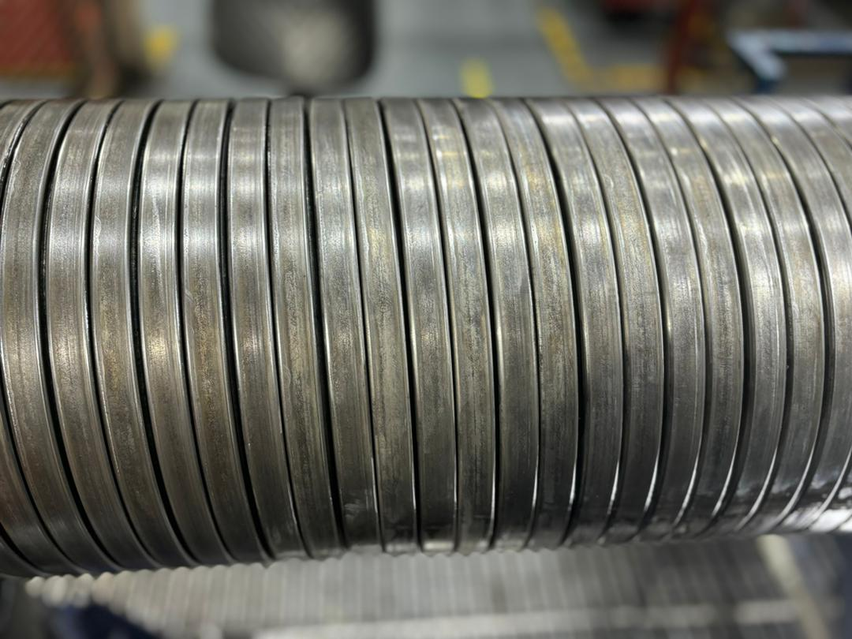
AFTER CHANGE NEW ROLLER
Figure 4 : Condition of zeta layer after changed new operation roller

Slide 8

THANK YOU

